Slide 1
Logistics Optimization for Delivery Routes – Amazon
SQL-Based Analytics Project
Name: MD ASMATH SHAIKH
Batch: DEC 2025
Date:13/03/2026

Slide 2
Business Background
Amazon operates a vast logistics network including:
Warehouses
Fulfillment centers
Delivery agents
Multi-city routes
Core Challenges:
Route congestion
Delivery delays
Warehouse bottlenecks
Agent performance inconsistency

Slide 3
Project Objective
Build a SQL-driven logistics analytics system to:-
Analyze delivery delays
Identify inefficient routes
Evaluate warehouse performance
Measure agent efficiency
Analyze shipment Tracking
KPI Reporting
Provide actionable recommendations

Slide 4
Dataset Overview
Tables Used:
Orders
Routes
Warehouses
Delivery_Agents
Shipment_Tracking
Key Fields:
Order_ID, Route_ID, Warehouse_ID,
Agent_ID,Traffic_Delay_Min, Distance_KM,
Processing_Time_Min, Status,
Delivery_status, Actual_Delivery_Time,
Expected_Delivery_Time

Slide 5

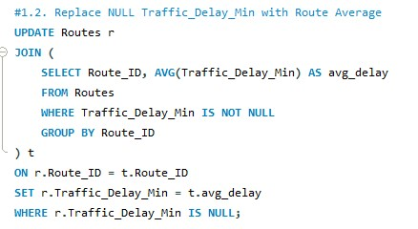
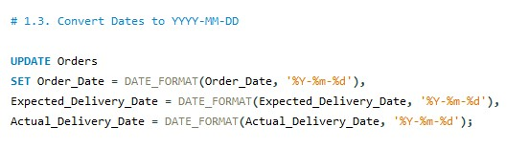
Task 1: Data Cleaning
Removed duplicate Order_ID records
Replaced NULL Traffic_Delay_Min with route average
Converted date fields to YYYY-MM-DD
Flagged invalid delivery records

Slide 6
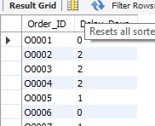
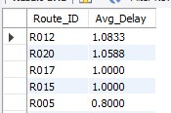
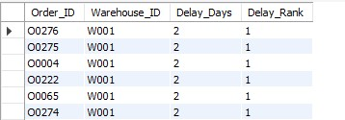
Task 2: Delivery Delay Analysis
Analysis Performed:
Calculated Delivery Delay using DATEDIFF
- Top 10 delayed routes
- Warehouse-level delay ranking
Ranked orders using window functions

Slide 7
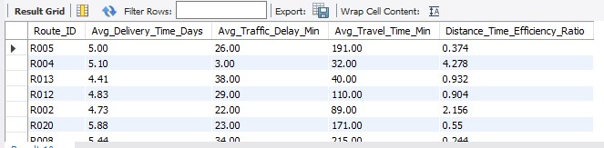
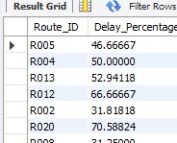
Task 3: Route Optimization Metrics
Metrics Calculated:
Average Delivery Time
Average Traffic Delay
Efficiency Ratio (Distance / Travel Time)
Percentage (%) of Delayed Shipments
Identified worst-performing routes

Slide 8
Route Optimization Insights
Issues Observed:
High congestion
Low efficiency ratio
High delay percentage
Recommended Actions:
Real-time rerouting
Dynamic dispatch timing
Route segmentation
Micro-fulfillment hubs

Slide 9

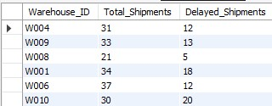
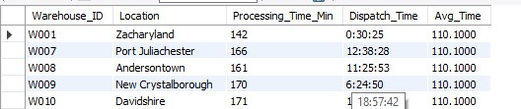
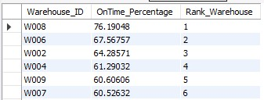
Task 4: Warehouse Performance
Analysis Conducted:
Top 3 warehouses by processing time
Total vs delayed shipments
Bottleneck warehouses using CTE
On-time delivery % ranking

Slide 10
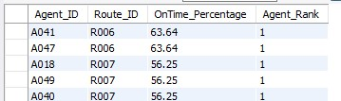
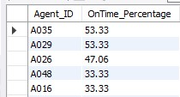

Task 5: Delivery Agent Performance
Metrics:
On-Time Delivery Percentage
Agent ranking per route
Agents below 80% performance
Speed comparison (Top 5 vs Bottom 5)
Insight: Higher speed often correlates with better on-time performance

Slide 11
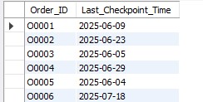

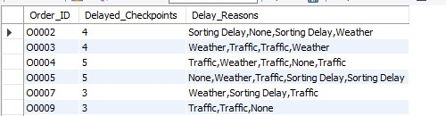
Task 6: Shipment Tracking Analytics
Last checkpoint per order
Most common delay reasons
Orders with >2 delayed checkpoints
Note: Repeated delays indicate operational breakdown

Slide 12
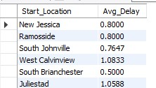

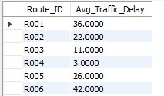
Task 7: KPI Dashboard
KPIs Generated:
Average Delivery Delay per Region
On-Time Delivery %
Average Traffic Delay per Route

Slide 13
Key Insights Summary
20% of routes cause majority of delays
Bottleneck warehouses impact multiple routes
Underperforming agents reduce efficiency
Traffic delay strongly impacts late deliveries

Slide 14
Business Recommendations
Implement AI-based route optimization
Reduce warehouse bottlenecks
Introduce agent performance monitoring
Use predictive traffic analytics
Trigger escalation after second delay

Slide 15
Conclusion
This SQL-driven analysis identified inefficiencies.
quantified performance gaps, and provided actionable
recommendations to improve logistics efficiency.
Estimated delay reduction potential: 15–25%

Slide 16
Video Submission
Google Drive Link- https://drive.google.com/file/d/1BzdfQLPRXAVpYinMSYaKCdA7EawdN3nW/view?usp=drive_link
Loom Link- https://www.loom.com/share/c81157497d5249e69ed1e9064857f691
Complate Project Link Google Drive
-

Slide 17


